Slide 1
Exploratory Data Analysis
Unit 02 Lecture 03
Dr Muhammad Ismail Mangrio

Slide 2
Contents
Exploring the Data Distribution
Exploring Binary and Categorical Data
Correlation
Exploring Two or More Variables
Hexagonal Binning and Contours

Slide 3

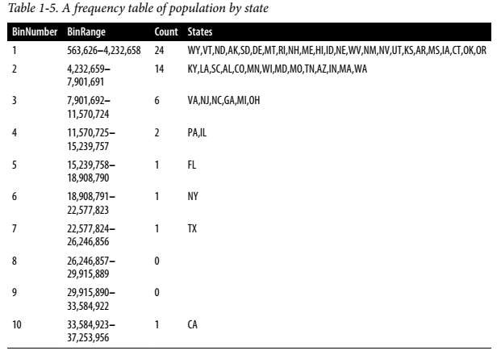
Frequency Tables and Histograms
▶ A frequency table of a variable divides up the variable range into equally spaced segments and tells us how many values fall within each segment.
▶ Table 1-5 shows a frequency table of the population by state computed.
▶ The function pandas.cut creates a series that maps the values into the segments.
▶ Using the method value_counts, we get the frequency table:

Slide 4

Frequency Tables and Histograms
The least populous state is Wyoming, with 563,626 people,
and the most populous is California, with 37,253,956 people.
This gives us a range of 37,253,956 – 563,626 = 36,690,330, which we must divide up into equal size bins—let’s say 10 bins.
With 10 equal size bins, each bin will have a width of 3,669,033, so the first bin will span from 563,626 to 4,232,658.
By contrast, the top bin, 33,584,923 to 37,253,956, has only one state: California.
The two bins immediately below California are empty, until we reach Texas.
It is important to include the empty bins; the fact that there are
no values in those bins is useful information.
It can also be useful to experiment with different bin sizes.
If they are too large, important features of the distribution can be obscured.
If they are too small, the result is too granular, and the ability to see the bigger picture is lost.
4

Slide 5
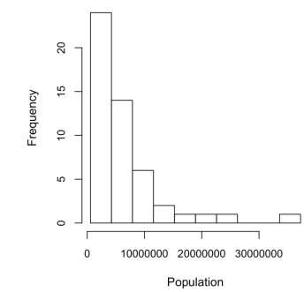
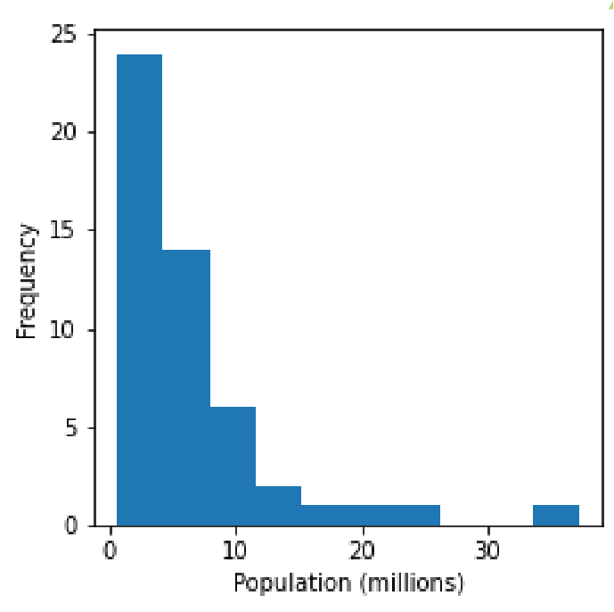
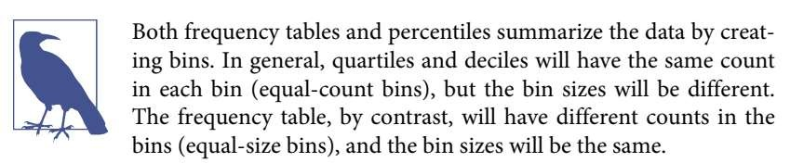
Frequency Tables and Histograms
A histogram is a way to visualize a frequency table, with bins on the x-axis and the data count on the y-axis.
A histogram is a way to visualize a frequency table, with bins on the x-axis and the data count on the y-axis.
The histogram is shown in Figure 1-3. In general, histograms are plotted such that:
  Empty bins are included in the graph.
  Bins are of equal width.
  The number of bins (or, equivalently, bin size) is up to the user.
  Bars are contiguous—no empty space shows between bars, unless there is an empty bin.

Slide 6
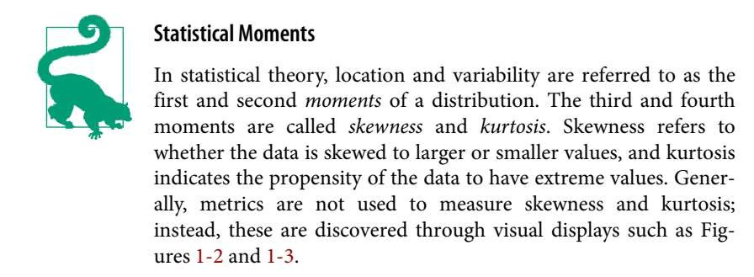
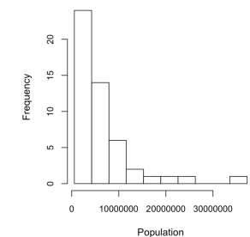
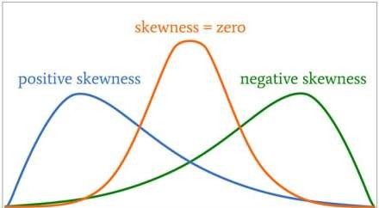
Frequency Tables and Histograms

Slide 7
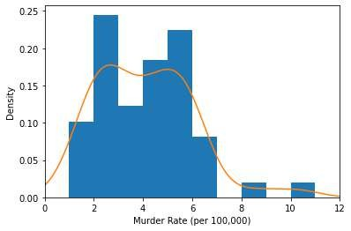
Density Plots and Estimates
Related to the histogram is a density plot, which shows the distribution of data values as a continuous line.
A density plot can be thought of as a smoothed histogram, although it is typically computed directly from the data through a kernel density estimate.
Figure 1-4 displays a density estimate superposed on a histogram.
pandas provides the density method to create a density plot. Use the argument bw_mthod to control the smoothness of the density curve:

Slide 8
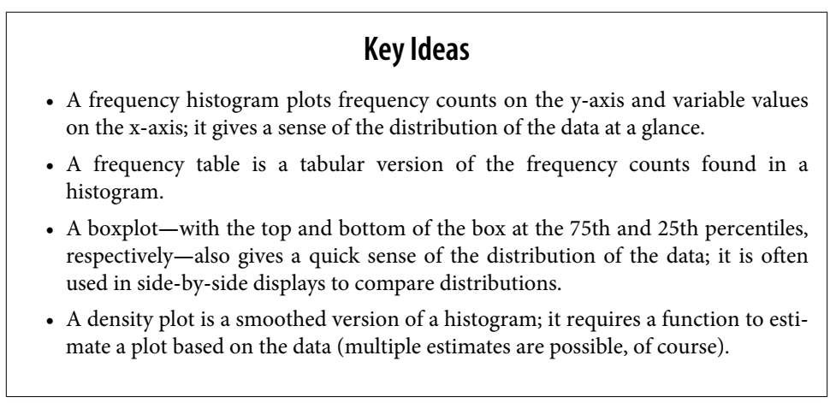
Density Plots and Estimates

Slide 9
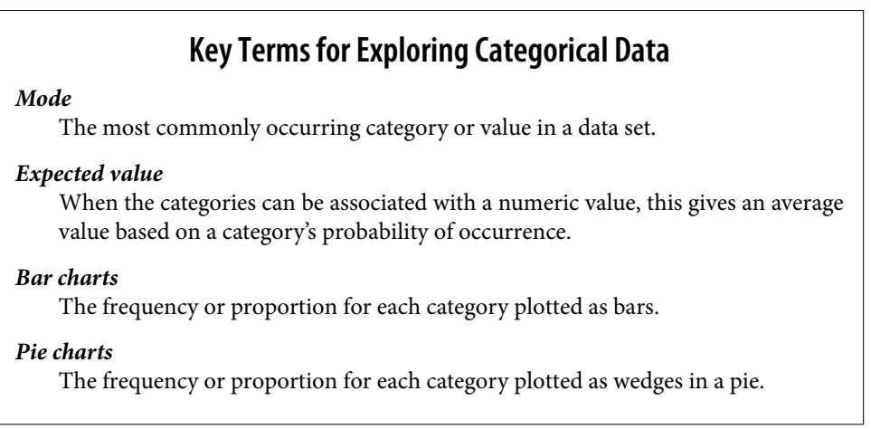
Exploring Binary and Categorical Data
For categorical data, simple proportions or percentages tell the story of the data.

Slide 10

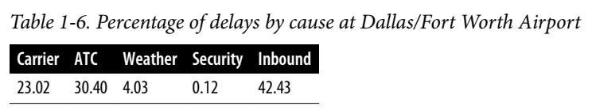
Exploring Binary and Categorical Data
▶ For categorical data, simple proportions or percentages tell the story of the data.
▶ Getting a summary of a binary variable or a categorical variable with a few categories is a fairly easy matter: we just figure out the proportion of 1s, or the proportions of the important categories.
▶ For example, Table 1-6 shows the percentage of delayed flights
by the cause of delay at Dallas/Fort Worth Airport since 2010.
▶ Delays are categorized as being due to factors under carrier control, air traffic control (ATC) system delays, weather, security, or a late inbound aircraft.

Slide 11


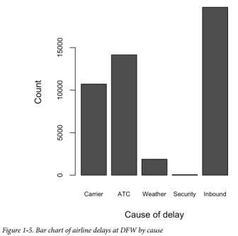
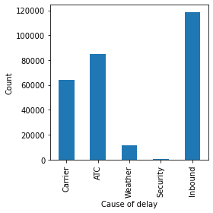

Exploring Binary and Categorical Data
▶ Bar charts, seen often in the popular press, are a common visual tool
for displaying a single categorical variable.
▶ Categories are listed on the x-axis, and frequencies or pro-portions on the y-axis.
▶ Figure 1-5 shows the airport delays per year by cause for Dallas/Fort Worth (DFW), and it is produced with the pandas also supports bar charts for data frames:

Slide 12

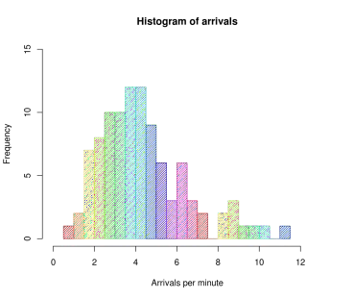

Exploring Binary and Categorical Data
Note that a bar chart resembles a histogram;
  in a bar chart the x-axis represents different categories of a factor variable, while in a histogram the x-axis represents values of a single variable on a numeric scale.
  In a histogram, the bars are typically shown touching each other, with
gaps indicating values that did not occur in the data.
  In a bar chart, the bars are shown separate from one another.

Slide 13
Exploring Binary and Categorical Data
Pie charts are an alternative to bar charts, although statisticians and data visualization experts generally avoid pie charts as less visually informative

Slide 14
Exploring Binary and Categorical Data: Mode
▶ The mode is the value/values, that appears most often in the data.
▶ For example, the mode of the cause of delay at Dallas/Fort Worth airport is “Inbound.”
▶ As another example, in most parts of the United States, the mode for religious preference would be Christian.
▶ The mode is a simple summary statistic for categorical data, and it is generally not used for numeric data.

Slide 15
Exploring Binary and Categorical Data: Expected Value
A special type of categorical data is data in which the categories
represent or can be mapped to discrete values on the same scale.
A marketer for a new cloud technology, for example, offers two levels of service,
  one priced at $300/month
  another at $50/month.
The marketer offers free webinars to generate leads, and the firm figures that
  5% of the attendees will sign up for the $300 service,
  15% will sign up for the $50 service, and
  80% will not sign up for anything.
This data can be summed up, for financial purposes, in a single “expected value,” which is a form of weighted mean, in which the weights are probabilities.

Slide 16
Exploring Binary and Categorical Data: Expected Value
The expected value is calculated as follows:
  Multiply each outcome by its probability of occurrence.
  Sum these values.
In the cloud service example, the expected value of a webinar attendee is thus $22.50 per month, calculated as follows:
EV = (0.05)(300) + (0.15)(50) + (0.80)(0) = 22 . 5
The expected value is really a form of weighted mean:
it adds the ideas of future expectations and probability weights, often based on subjective judgment.
Expected value is a fundamental concept in business valuation and capital budgeting—For example,
  the expected value of five years of profits from a new acquisition, or
the expected cost savings from new patient management software at a clinic.
16

Slide 17
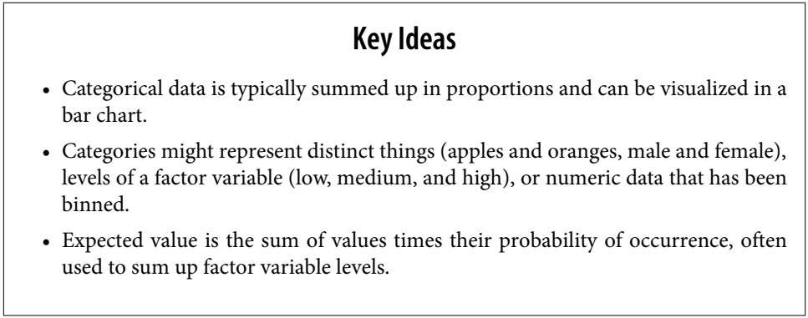
Exploring Binary and Categorical Data: Probability

Slide 18
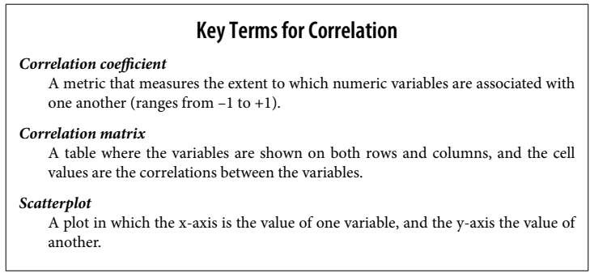
Correlation

Slide 19
Correlation
Exploratory data analysis in many modeling projects (whether in data science or in research) involves examining correlation among predictors, and between predictors and a target variable.
Variables X and Y (each with measured data) are said to be positively correlated
  if high values of X go with high values of Y, and low values of X go with low
values of Y.
If high values of X go with low values of Y, and vice versa, the variables are
negatively correlated.
Consider these two variables,
  perfectly correlated in the sense that each goes from low to high: v1: {1, 2, 3} , v2:
{4, 5, 6}
  The vector sum of products is 1 · 4 + 2 · 5 + 3 · 6 = 32.
  Now try shuffling one of them and recalculating—the vector sum of products will
never be higher than 32.
  So this sum of products could be used as a metric; that is, the observed sum of₁₉ 32 could be compared to lots of random shufflings.

Slide 20

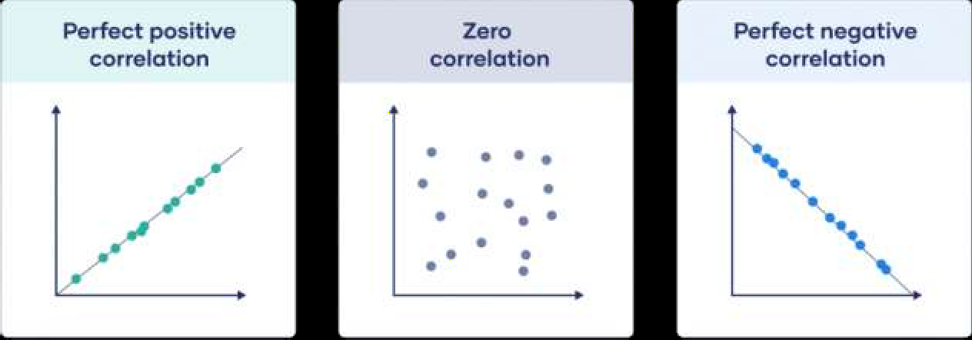
Correlation
More useful is a standardized variant: the correlation coefficient, which gives an estimate of the correlation between two variables that always lies on the same scale.
To compute Pearson’s correlation coefficient, we multiply deviations from the mean for variable 1 times those for variable 2, and divide by the product of the standard deviations:
The correlation coefficient always lies between
➢ +1 (perfect positive correlation) and
  –1 (perfect negative correlation);
  0 indicates no correlation.

Slide 21
Correlation
Variables can have an association that is not linear, in which case the
correlation coefficient may not be a useful metric.
The relationship between tax rates and revenue raised is an example: as tax rates increase from zero, the revenue raised also increases.
However, once tax rates reach a high level and approach 100%, tax
avoidance increases and tax revenue actually declines.

Slide 22
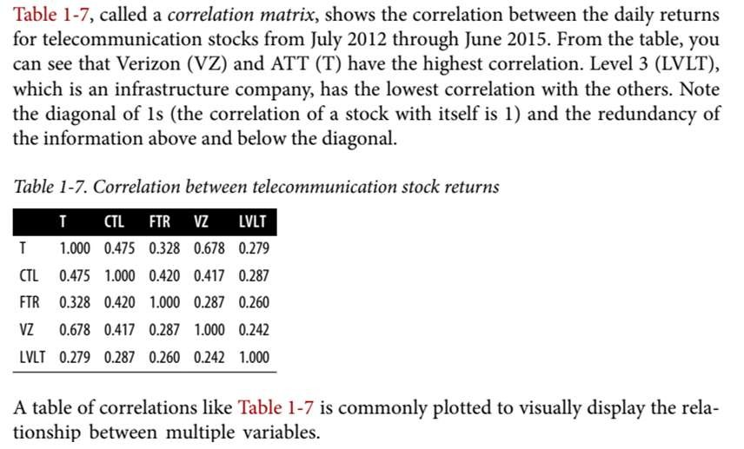
Correlation

Slide 23

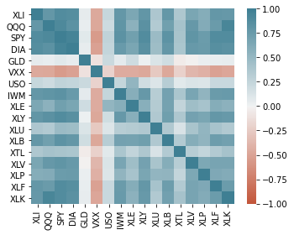
Correlation

Slide 24

Correlation
The ETFs for the S&P 500 (SPY) and the Dow Jones Index (DIA) have a high correlation.
Similarly, the QQQ and the XLK, composed mostly of technology companies, are positively correlated.
Defensive ETFs, such as those tracking gold prices (GLD), oil prices (USO), or market volatility (VXX), tend to be weakly or negatively correlated with the other ETFs.

Slide 25
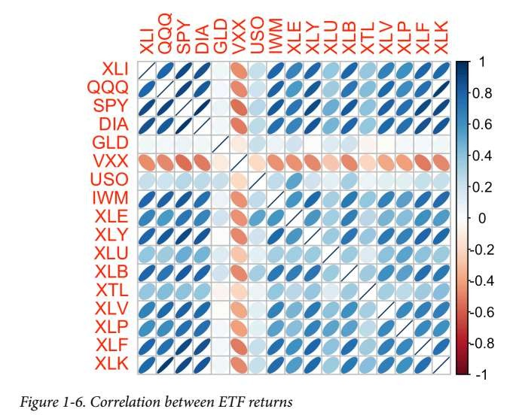
Correlation
25

Slide 26
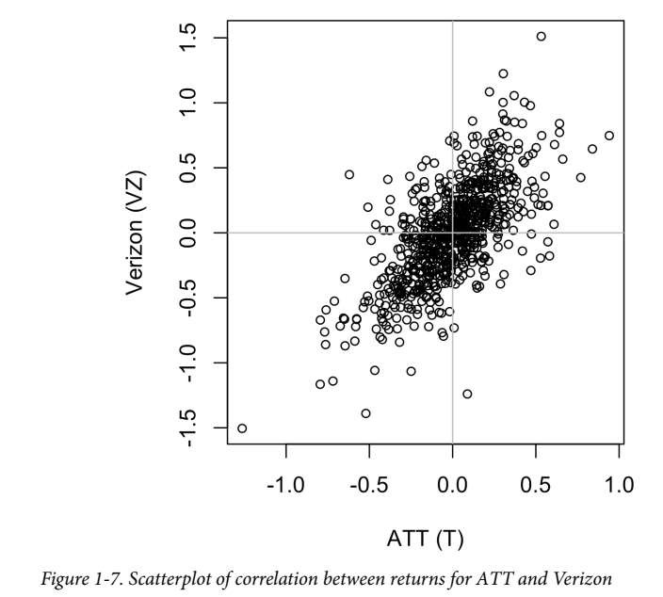
Correlation: Scatterplots
The standard way to visualize the relationship between two measured data variables is with a scatterplot.
The x-axis represents one variable and the y-axis another, and each point on the graph is a record.
See Figure 1-7 for a plot of the correlation between the daily returns for ATT and Verizon.

Slide 27
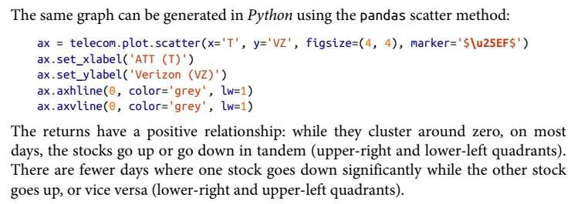

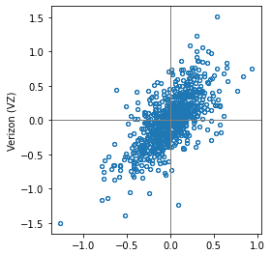
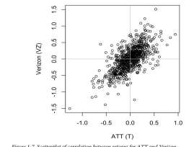
Correlation: Scatterplots

Slide 28
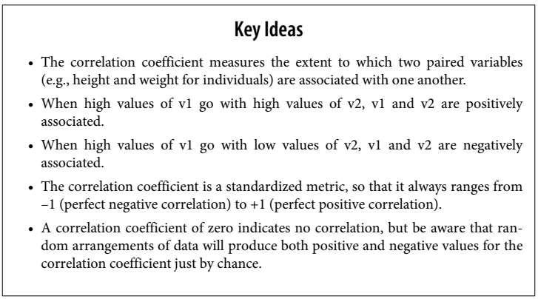
Correlation

Slide 29
Exploring Two or More Variables

Slide 30
Exploring Two or More Variables
Familiar estimators like mean and variance look at variables one at a time (univariate analysis).
Correlation analysis (see “Correlation” on page 30) is an important method that compares two variables (bivariate analysis).
In this section we look at additional estimates and plots, and at more than two variables (multivariate analysis).
The appropriate type of bivariate or multivariate analysis depends on the nature of the data: numeric versus categorical.

Slide 31
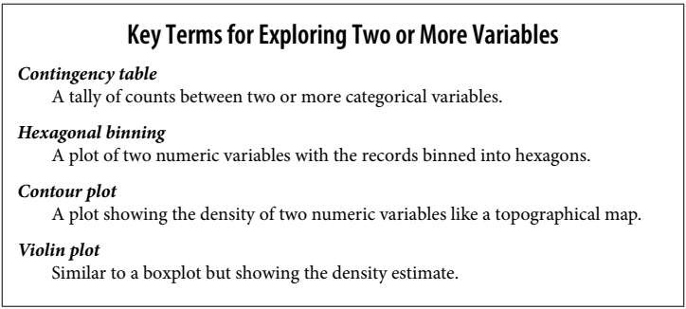

Slide 32
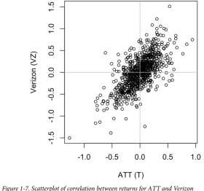
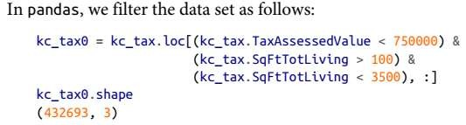
Hexagonal Binning and Contours (Plotting Numeric Versus Numeric Data)
Scatterplots are fine when there is a relatively small number of data values.
The plot of stock returns in Figure 1-7 involves only about 750 points.
For data sets with hundreds of thousands or millions of records, a scatterplot will be too dense, so we need a different way to visualize the relationship.
To illustrate, consider the data set kc_tax, which contains the tax-assessed values
for residential properties in King County, Washington.
In order to focus on the main part of the data, we strip out very expensive and very small or large residences using the subset function:

Slide 33
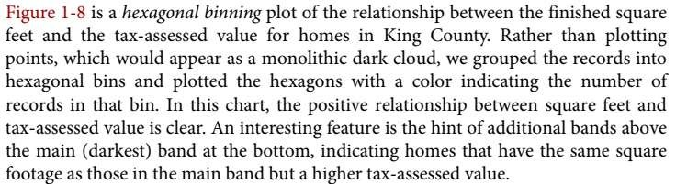
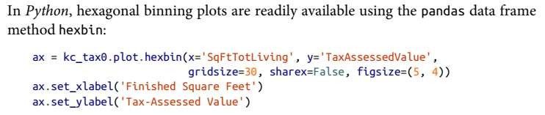
Hexagonal Binning (Plotting Numeric Versus Numeric Data)

Slide 34
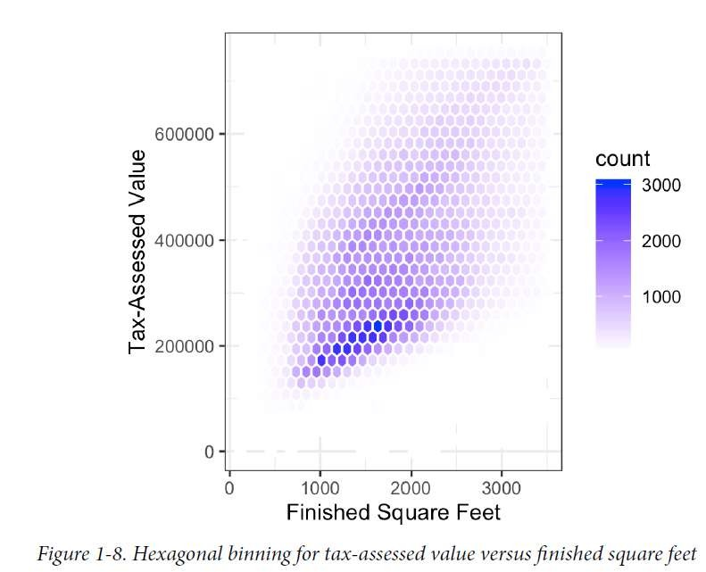
Hexagonal Binning (Plotting Numeric Versus Numeric Data)

Slide 35
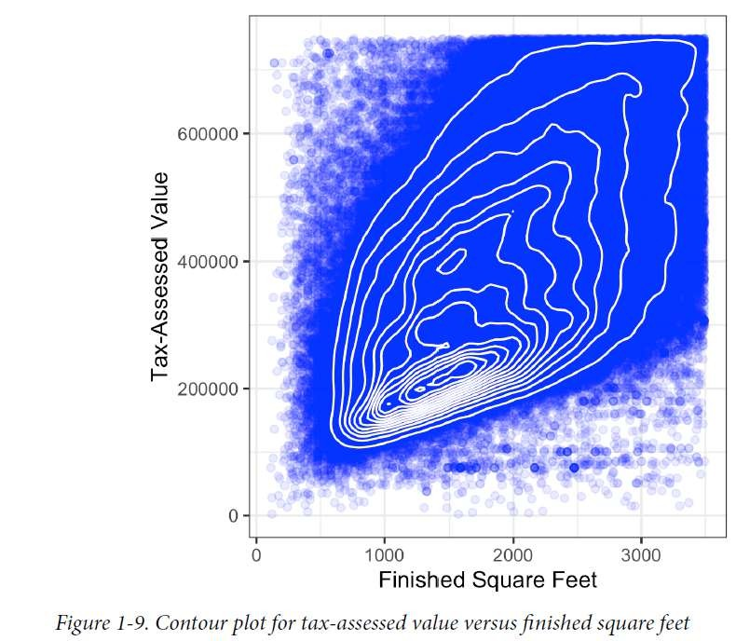
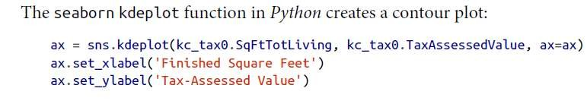
Contours (Plotting Numeric Versus Numeric Data)
Figure 1-9 uses contours overlaid onto a scatterplot to visualize the relationship between two numeric variables.
The contours are essentially a topographical map to two variables; each contour band represents a specific density of points, increasing as one nears a “peak.” KhanAcademy-Contours plot
Other types of charts are used to show the relationship between two numeric variables, including heat maps.
  Heat maps, hexagonal binning, and contour plots all give a visual representation of a two- dimensional density.

Slide 36
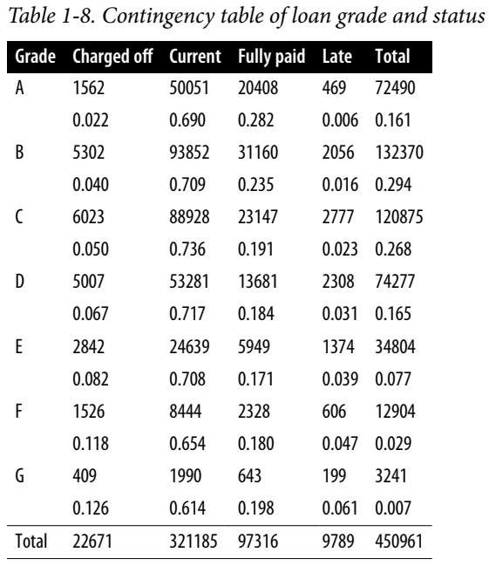
Two Categorical Variables
A useful way to summarize two categorical variables is a contingency table—a table of counts by category.
Table 1-8 shows the contingency table between the grade of a personal loan and the outcome of that loan.

Slide 37
Two Categorical Variables
This is taken from data provided by Lending Club, a leader in the peer-to-peer lending business.
The grade goes from A (high) to G (low).
The outcome is either fully paid, current, late, or charged off (the balance of the loan is not expected to be collected).
This table shows the count and row
percentages.
High-grade loans have a very low late/charge- off percentage as compared with lower-grade loans.
Contingency tables can look only at counts, or they can also include column and total percentages.

Slide 38
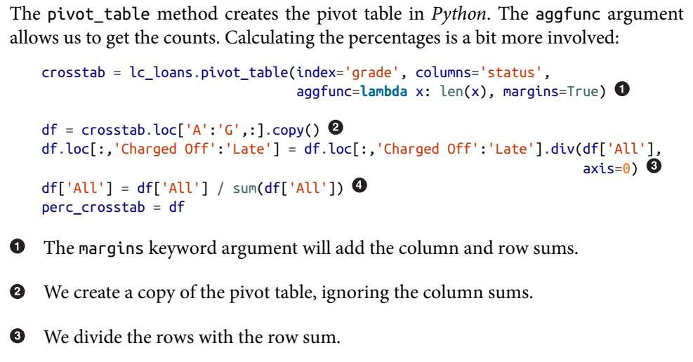
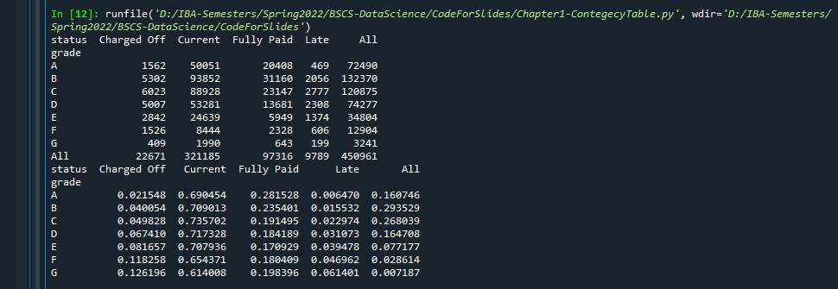

Two Categorical Variables

Slide 39
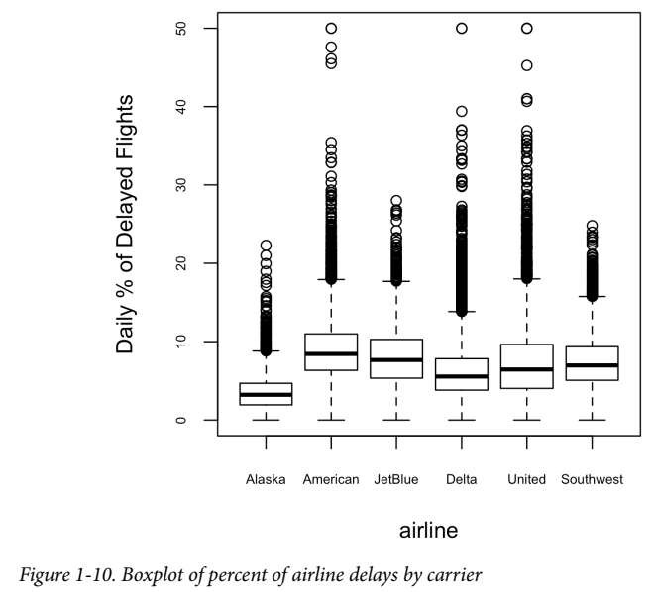

Categorical and Numeric Data
▶ Boxplots (see “Percentiles and Boxplots” on
page 20) are a simple
compare the distributions
way to visually
of a numeric
variable grouped according to a categorical variable.
▶ For example, we might want to compare how the percentage of flight delays varies across airlines.
▶ Figure 1-10 shows the percentage of flights in a month that were delayed where the delay was within the carrier’s control:
▶ The pandas boxplot method takes the by argument that splits the data set into groups and creates the individual boxplots:

Slide 40
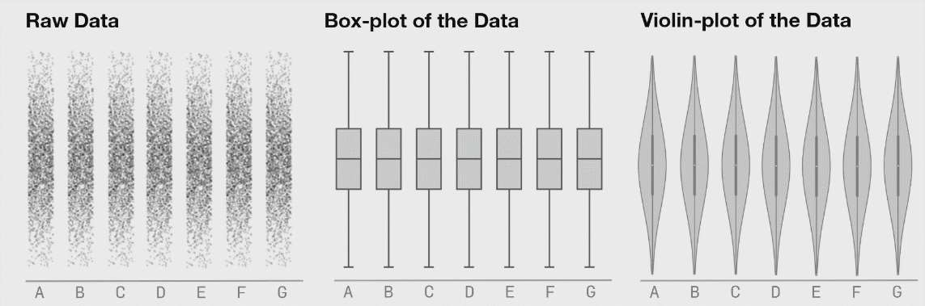
Categorical and Numeric Data
▶ A violin plot, introduced by [Hintze-Nelson-1998], is an enhancement to the boxplot and plots the density estimate with the density on the y-axis.
▶ The density is mirrored and flipped over, and the resulting shape is filled in, creating an image resembling a violin.
▶ The advantage of a violin plot is that it can show nuances in the distribution that aren’t perceptible in a boxplot.

Slide 41
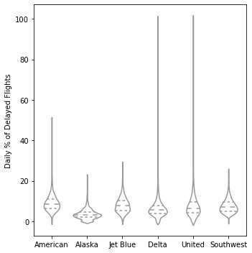
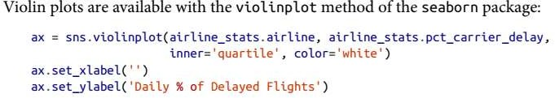
Categorical and Numeric Data
The corresponding plot is shown in Figure 1-11.
The violin plot shows a concentration in the distribution near zero for Alaska and, to a lesser extent, Delta.
This phenomenon is not as obvious in the boxplot. You can combine a violin plot with a boxplot by adding geom_boxplot to the plot (although this works best when colors are used).

Slide 42
Categorical and Numeric Data
The corresponding plot is shown in Figure 1-11.
The violin plot shows a concentration in the distribution
near zero for Alaska and, to a lesser extent, Delta.
This phenomenon is not as obvious in the boxplot. You can combine a violin plot with a boxplot by adding geom_boxplot to the plot (although this works best when colors are used).
42

Slide 43
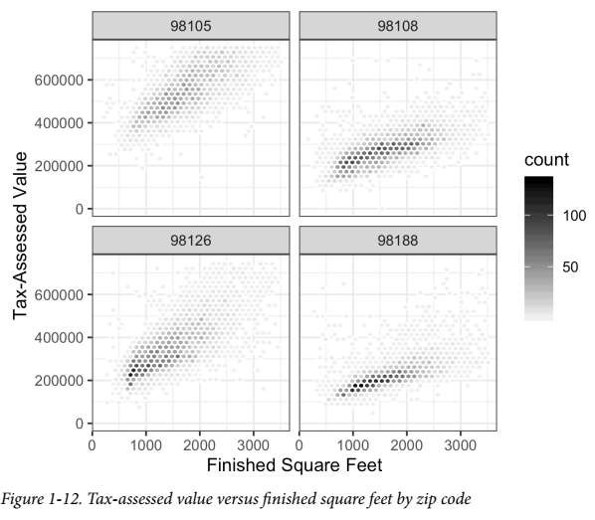
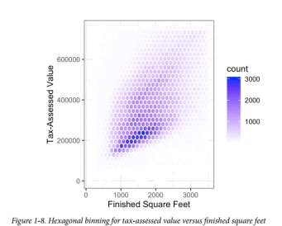
Visualizing Multiple Variables
As an example, look back at Figure 1-8, which showed the relationship between homes’ finished square feet and their tax-assessed values.
We observed that there appears to be a cluster of homes that have higher tax-assessed value per square foot.
Diving deeper, Figure 1-12 accounts for the effect of location by plotting the data for a set of zip codes.
Now the picture is much clearer: tax-assessed value is much higher in some zip codes (98105, 98126) than in others (98108, 98188).
This disparity gives rise to the clusters observed in Figure 1-8.

Slide 44
Acknowledgement
A part of material for the creation of this lecture was taken from Dr. Ghulam Murtaza slides.

Slide 45
Summary
In this lecture we studied following topics
  Estimate of central location of data
  Variability of Data
  Single, Bi and Multivariate analysis
  Correlation
  Different plots for visualization of data

